Slide 1
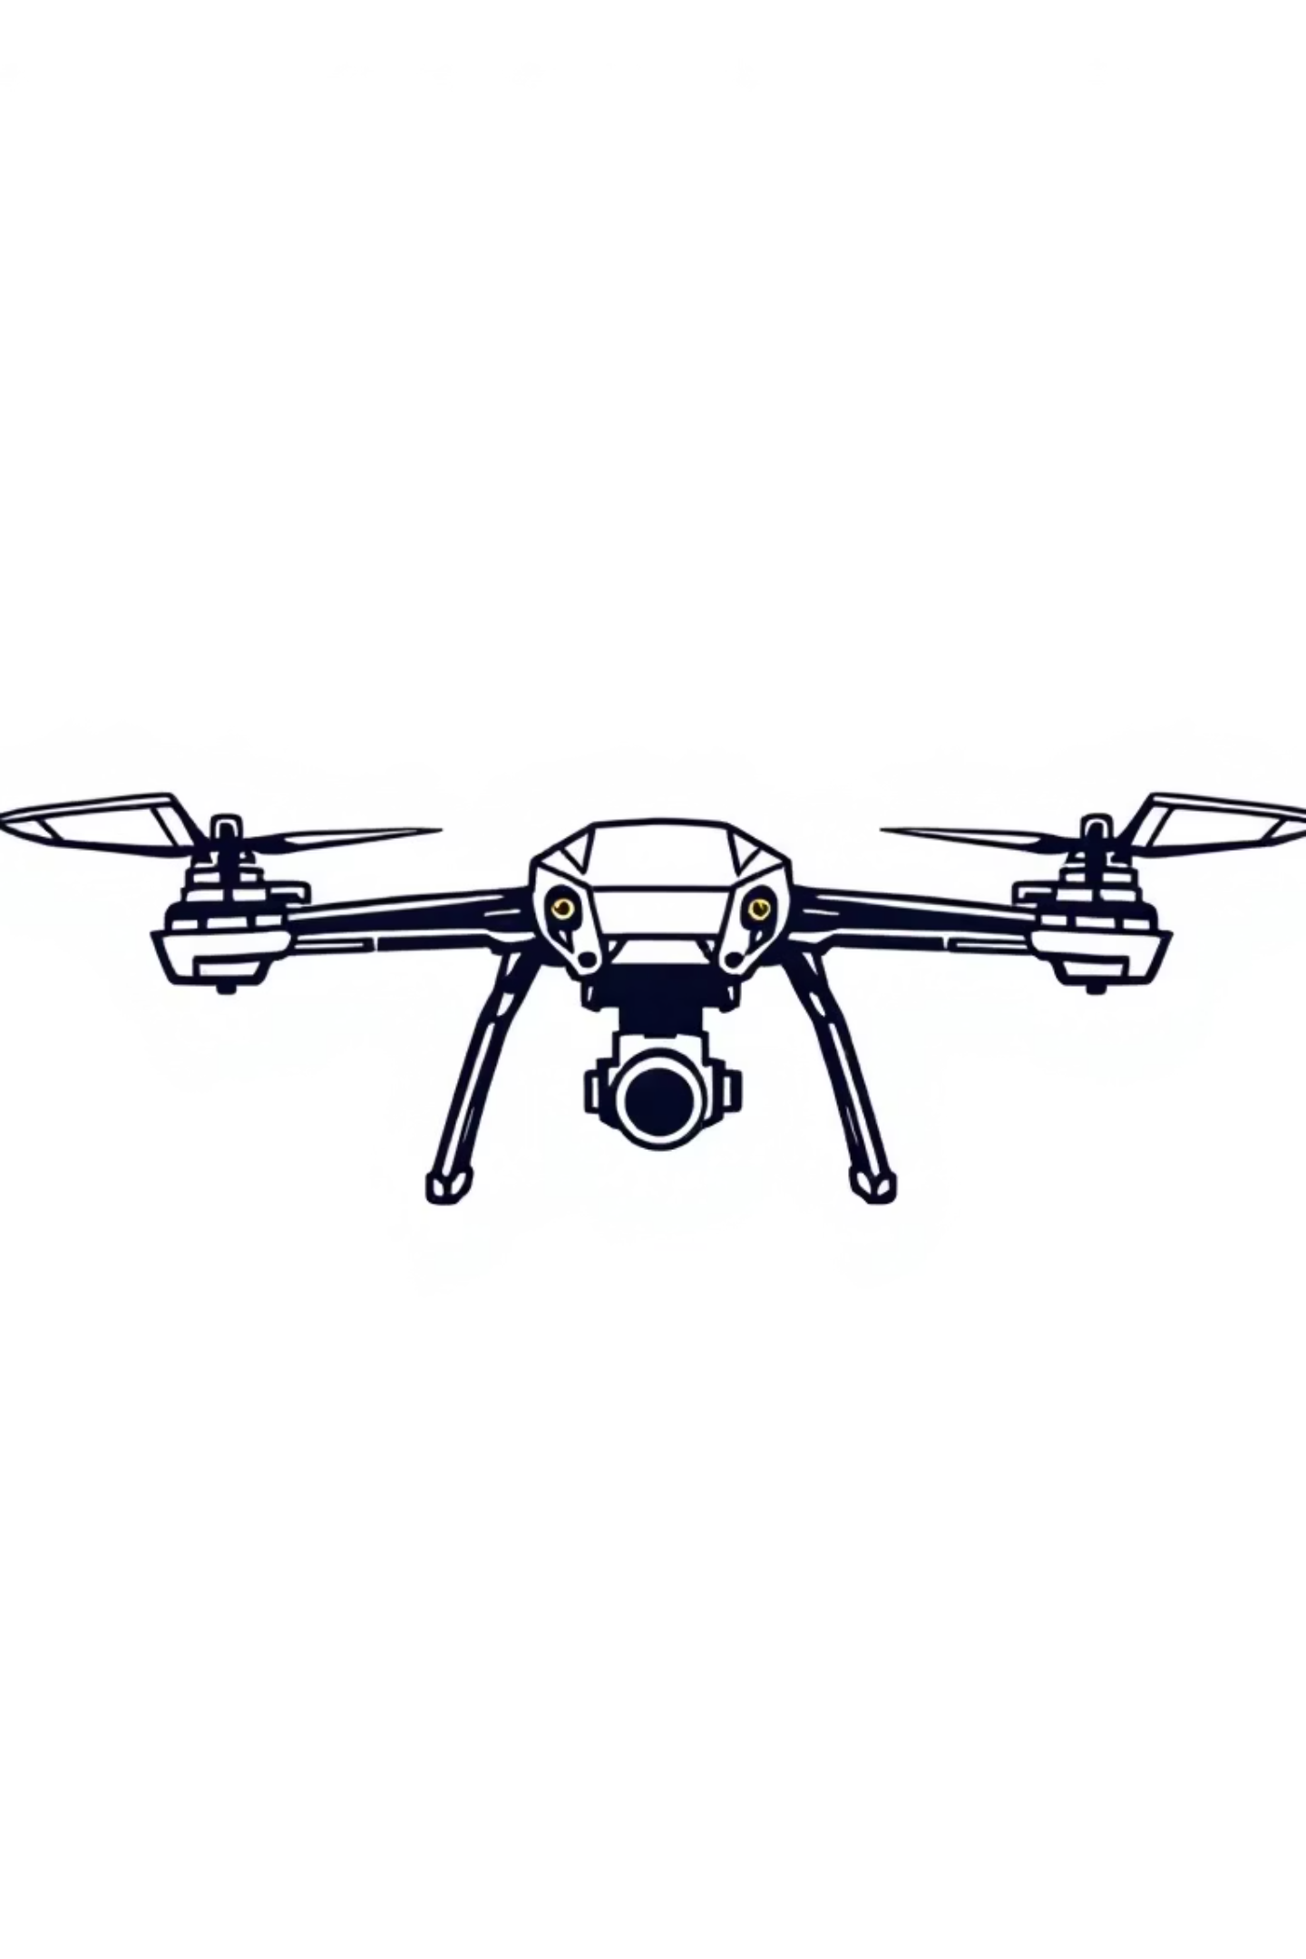

Krishna T. Patel 240141105831023 Control Systems Sem 3 SASET, RRU
Application of Control Systems: Drone Altitude Hold
Controlling an Unstable System with PID

Slide 2
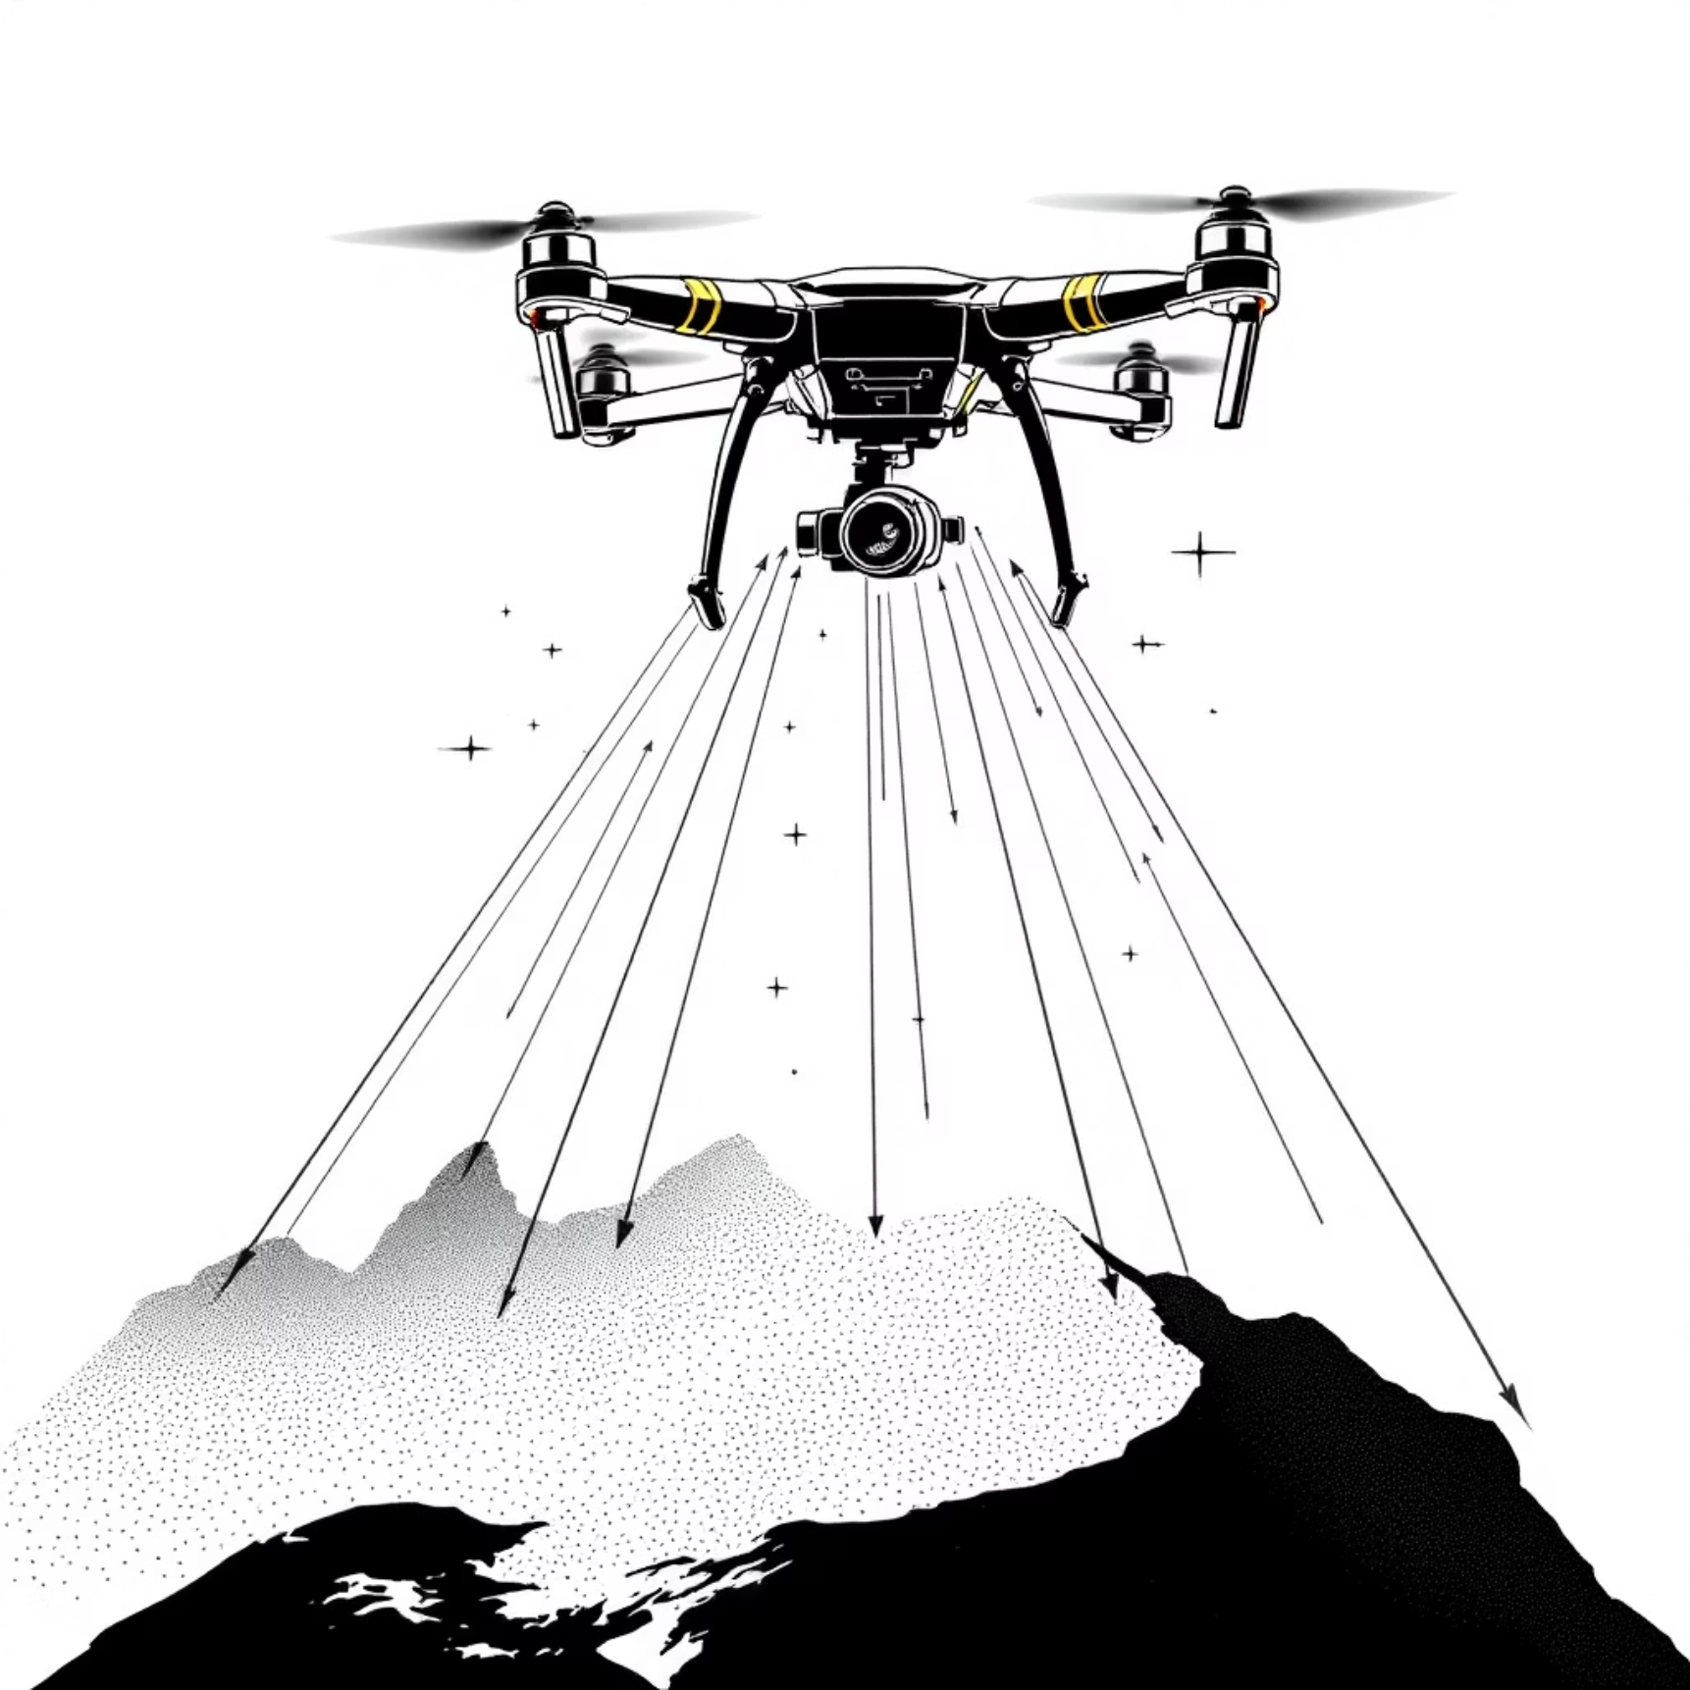



The Challenge: Hovering Against Gravity
Project Goal
Command a drone to take off and hover at a fixed altitude (10 metres)
Core Physics Problem
Drone altitude behaves as a double integrator (1/s²) — inherently unstable
System Type
Unstable 2nd-order control challenge
I Term: Gravity Fighter
Cancels constant disturbance, eliminates steady-state error
D Term: Damper
Stops oscillations, adds stability

Slide 3
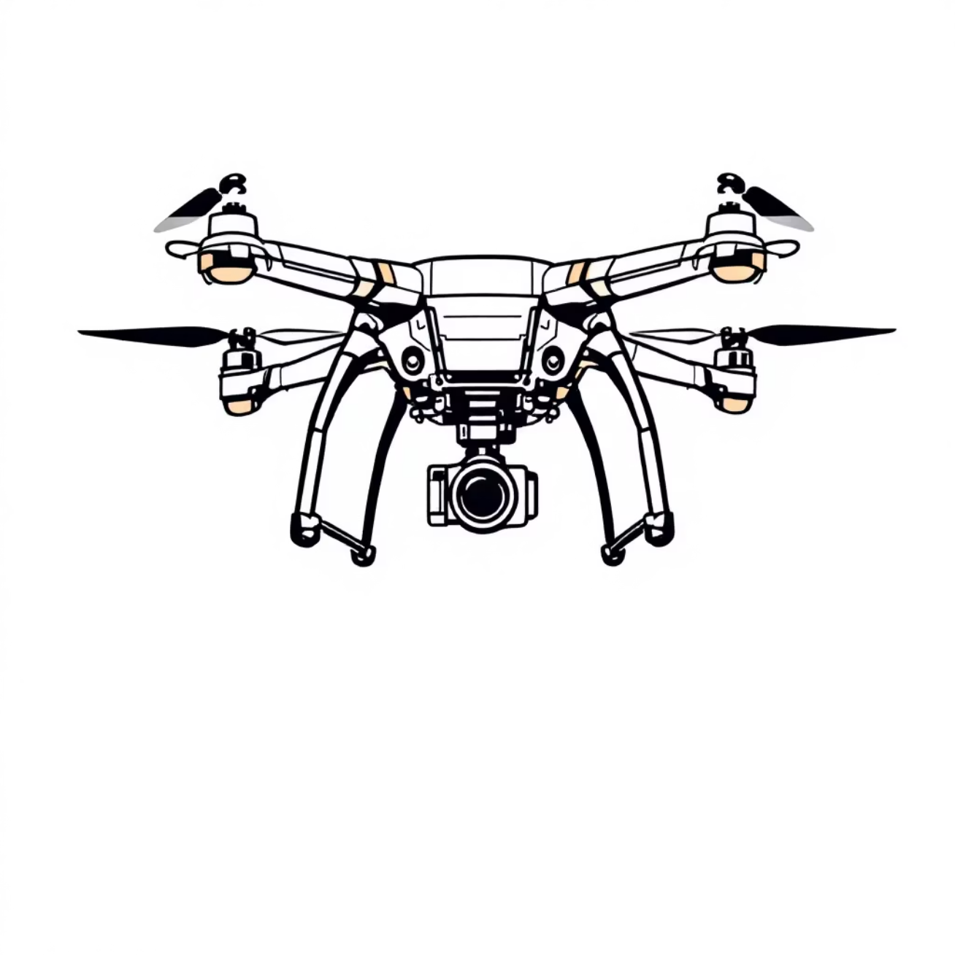


Introduction & Objective
What is Altitude Hold?
A control system that maintains a drone (quadcopter) at a fixed altitude, even with disturbances
One of the most fundamental functions of any drone
The Real-World Challenge
Instability: Thrust-to-altitude physics is a double integrator (1/s²) — naturally unstable, like balancing a pole on your hand
Gravity: Controller must constantly provide sufficient thrust to overcome downward pull
Project Objective: Build a Simulink model demonstrating that P-Controller is unstable, PD-Controller stabilises but leaves error, and PID-Controller achieves stable and accurate control

Slide 4
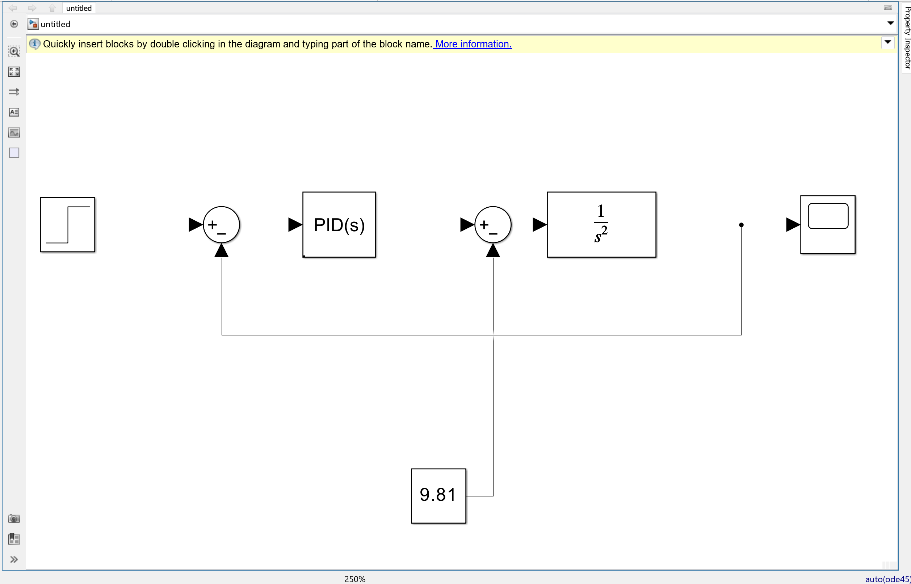

Slide 5
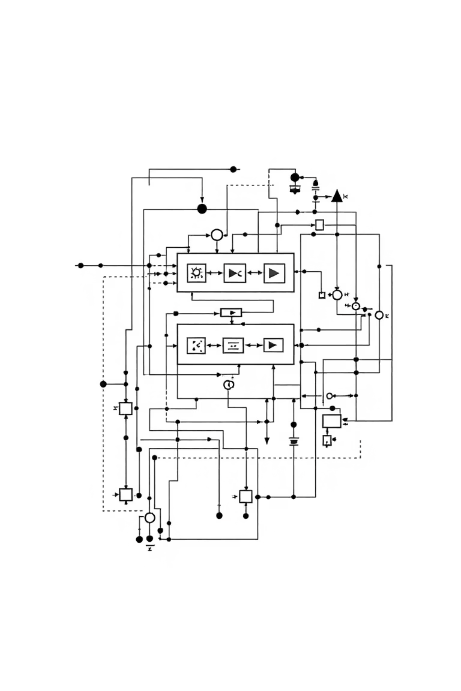

Building the Simulink Model
01
System Model (Drone Physics)
Transfer function: 1/s² (assumes mass = 1 kg)
Transfer Fcn block with Numerator [1], Denominator [1 0 0]
02
Control Loop Components
Step block (Desired Altitude = 10), Sum block (+-), PID Controller, Scope for output
03
Gravity Disturbance
Constant block (9.81 N), added via Sum block between PID and Transfer Fcn
04
Simulation Parameters
Stop Time: 20 seconds

Slide 6
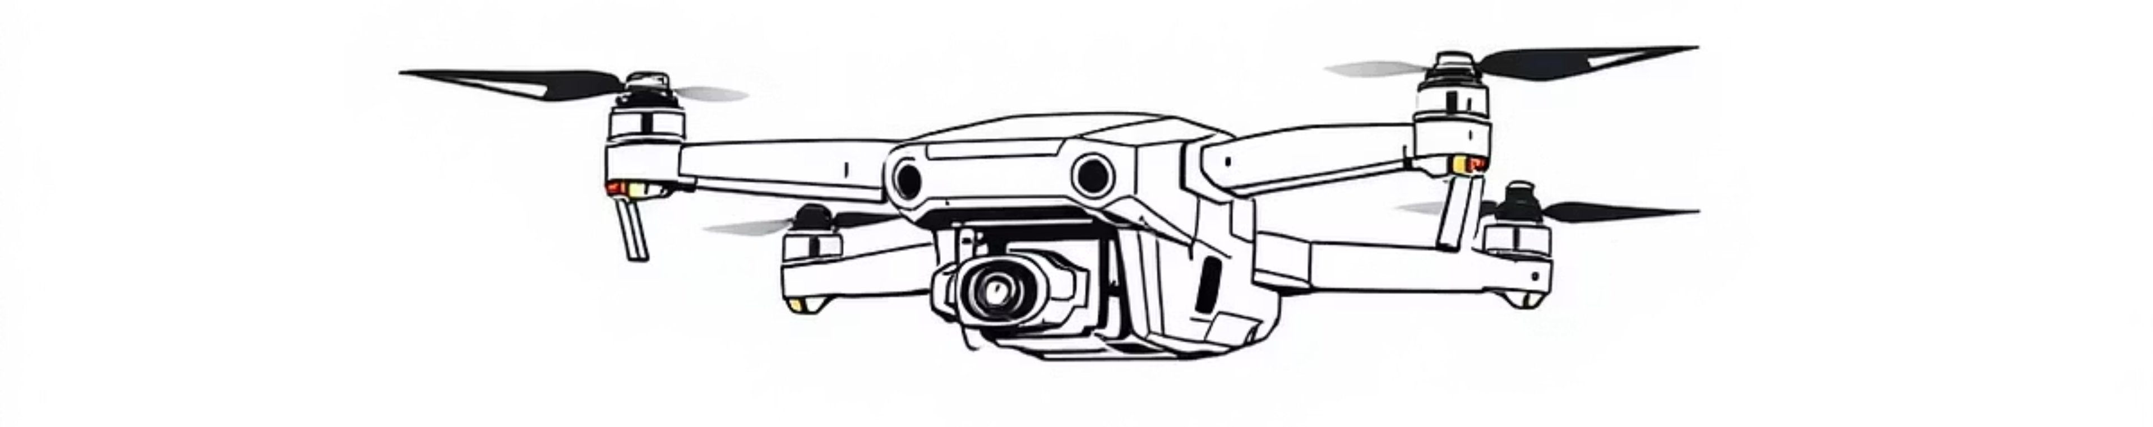




What the Experiment Demonstrates
Test 1: P Only
Test 2: PD
Test 3: PID
P = 2
P = 2, D = 3
P = 2, I = 1, D = 3
Wildly unstable — oscillations grow to infinity
Stable but inaccurate — settles at ~7m (steady-state error)
Perfect control — stable and reaches exactly 10m

Slide 7
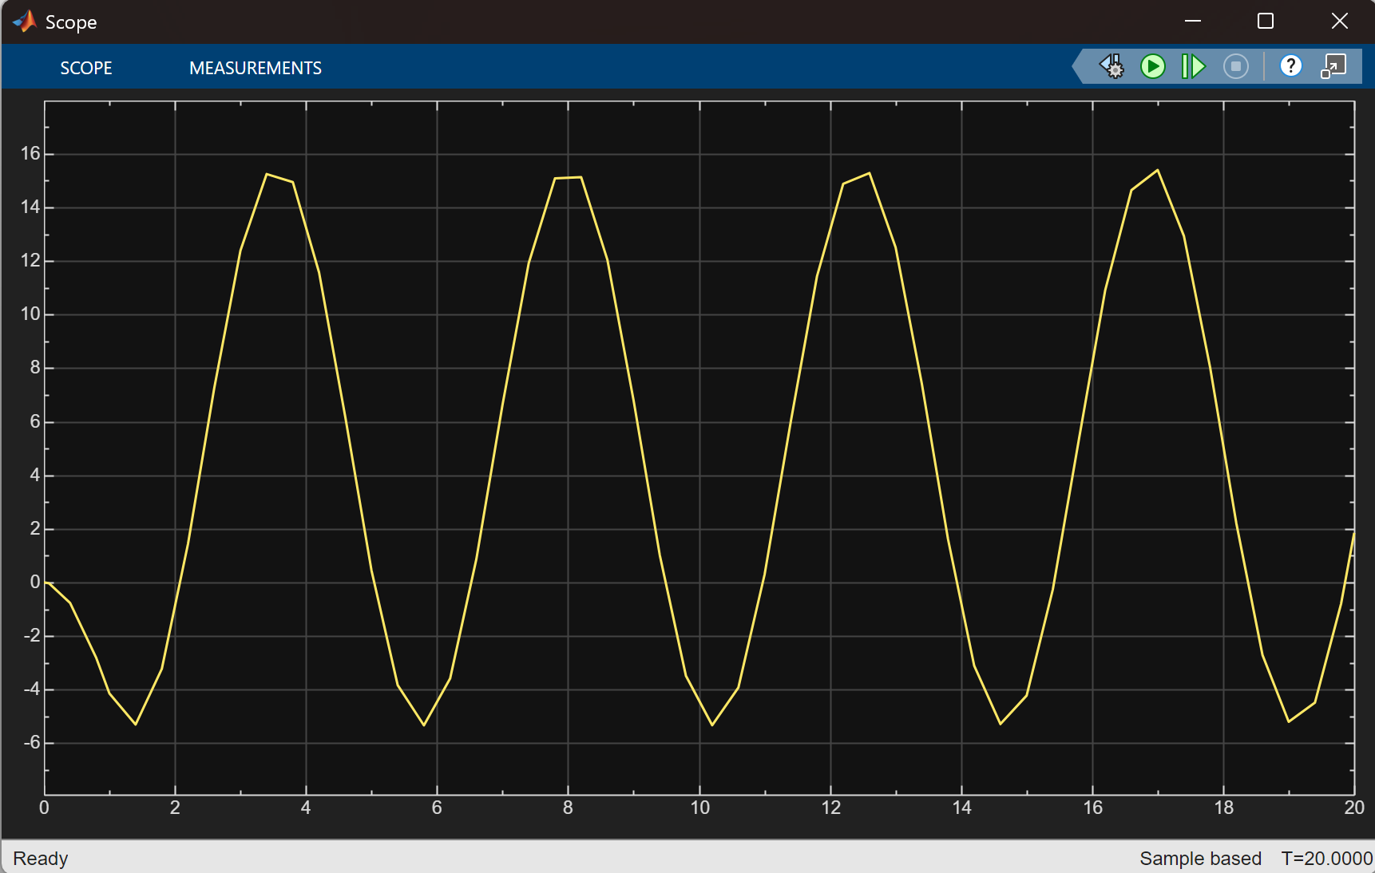
Case 1: P-Controller Only
The Experiment
Controller Type: P
P = 2
Command: Go to 10m
Analysis
Total Failure
System is unstable — oscillations grow forever
P-controller alone cannot damp oscillations
Scope output showing altitude oscillating to infinity — sine wave with increasing amplitude

Slide 8
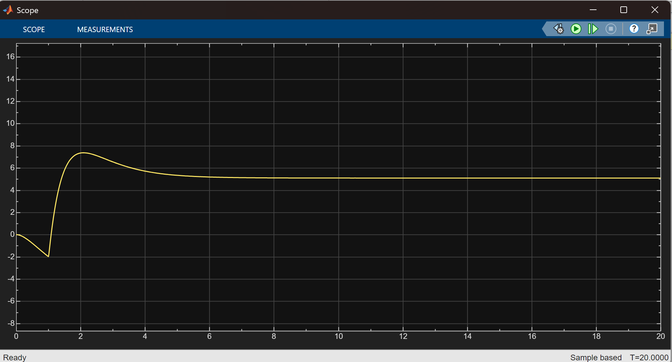
Case 2: PD-Controller (Adding Stability)
The Experiment
Controller Type: PD
P = 2, D = 3
Command: Go to 10m
Analysis
Partial Success
D term adds damping (acts like a brake) — system now stable
But: Large steady-state error
Settles at ~7m — cannot reach 10m target
Scope output showing altitude rising, slight overshoot, settling at ~7 metres below target

Slide 9
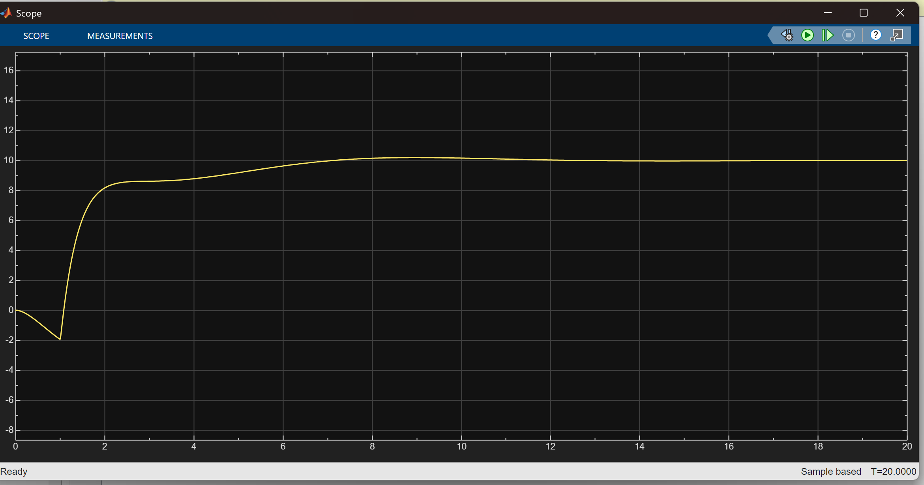
Case 3: PID-Controller (The Full Solution)
The Experiment
Controller Type: PID
P = 2, I = 1, D = 3
Command: Go to 10m
The Result
Perfect Control
System is stable (D term)
Altitude reaches exactly 10 metres and stays there (I term)
Zero steady-state error
Scope output showing altitude rising, stabilising, and settling precisely at 10 metres

Slide 10
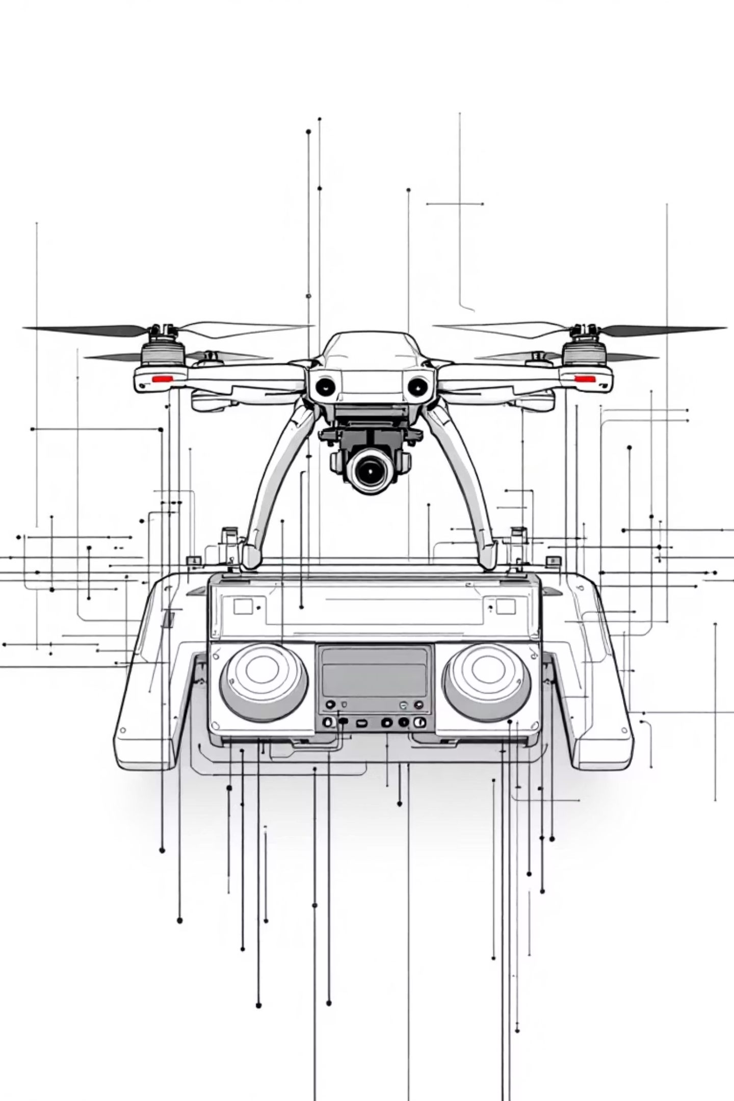



Why PID is Essential for Drones
D Term (Derivative)
I Term (Integral)
Provides stability — stops oscillations through damping action
Eliminates error — sees the gap (10m - 7m) and adds extra thrust to perfectly cancel gravity and reach target
P Term (Proportional)
Provides main control action — responsive to error magnitude
Conclusion
Full PID control is essential for complex, unstable systems like drones — each term plays a critical role in achieving stable, accurate altitude hold

